Slide 1
Graph Algorithms for Dark Web analysis
Seminar -1

Slide 2
Contents…….
Previous Work
Karate Club
Iron March embeddings
Basics of Graph and how is it useful
Node2Vec and embeddings
Algorithms in Research Paper
New approaches
Various other algorithms/methodologies

Slide 3
#1 Previous Works - Karate Club
The data points represent people enrolled in the Karate club.
Nodes 1 and 34 represent the Sensei and Owner respectively.
The motivation for the analysis was the fact that they wanted to separate and hence, had to analysis as to how many students would join whom.
The 3 - step algorithm is to make the graph embeddings ( preparation step ) and then make clusters ( analysis step ) and then plotting them ( visualization step ).

Slide 4
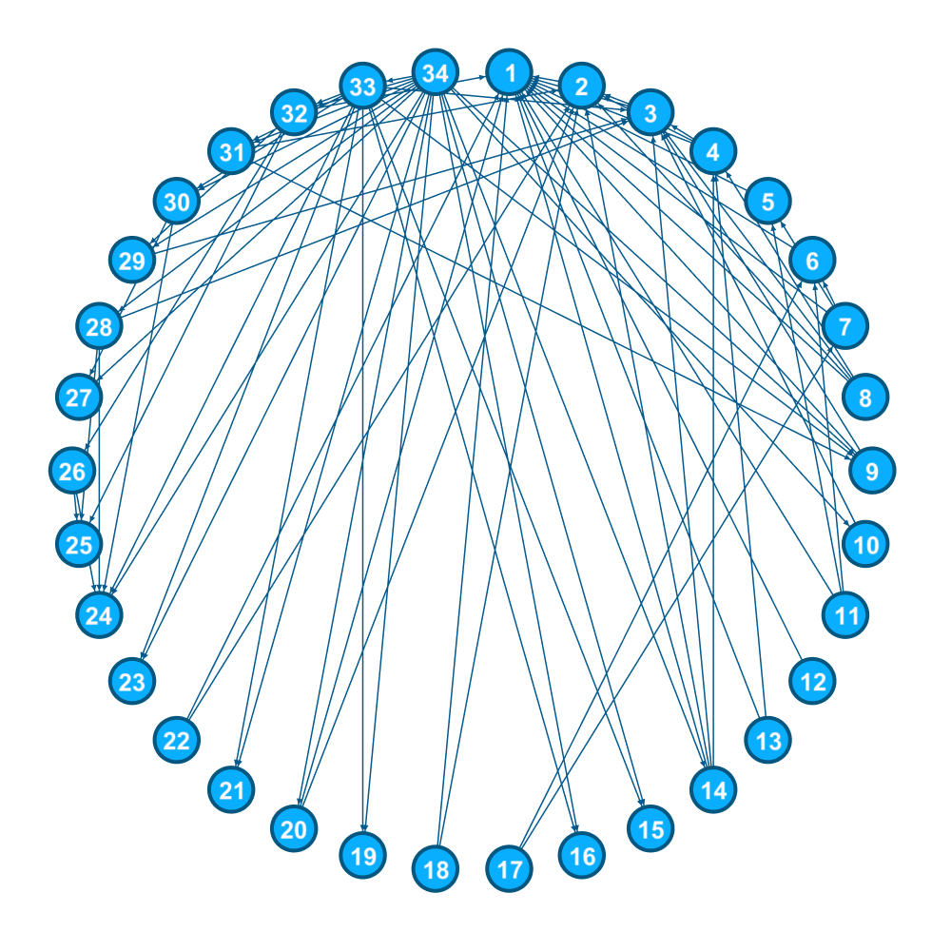
Node 1 is the Sensei.
Node 34 is the owner.
We need to use the structural features to find out who joins whom.
https://en.wikipedia.org/wiki/Zachary%27s_karate_club

Slide 5
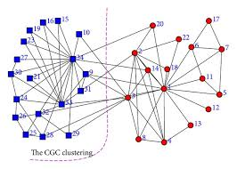
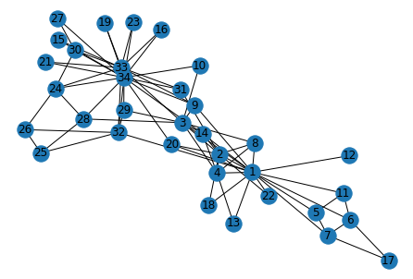
Reason : Random Walks are actually random !!!!
Applied PCA to reduce the dimensions to 2 from 128
Only Mismatch are Node 14, 3, 20
And that too, they are very close to both of them

Slide 6
#2 Graph Basics and how it can be useful
Explicit link to nodes with relations embedded in nodes, Edges and their connectional structure.
Node labels and Edge labels are an add on to it.
Can have features to represent the nodes.
They are type of Non-Euclidean data type
Networkx - Clustering coefficient.

Slide 7
How it can be useful
Social Network analysis
Community Detection
Link Prediction
Relational ripple effect
Manipulate Unstructured data
Knowledge graphs
Structural Boot-strapping
Geometrical Analysis
Correlational ratio

Slide 8
#3 Node2Vec and Embeddings
Read the parameters
Graph
P - controlling the BFS
Q - controlling the DFS
Pre-process the probabilities
Simulate the walk
No. of iterations
Walk length
Gensim - Word2vec
Embedding length
Window size
Notes:
https://github.com/eliorc/node2vec/blob/master/node2vec/node2vec.py

Slide 9
Clustering of the embeddings
Hierarchical clustering - Distance between points
Centroid-based clustering - Elliptical or spherical geometry
Graph-based clustering - Best for higher dimensional clusters
Density-based clustering - Slide the window on largely dense data points
Amalgumation - HDBSCAN

Slide 10
#4 Further Algorithms analysed
GCNs
Methods for link prediction
Random walks based
Deep Walk and Node2Vec
LINE
GraphSAGE
Tensor based
RESCEL
TransE
Positive Sampling

Slide 11
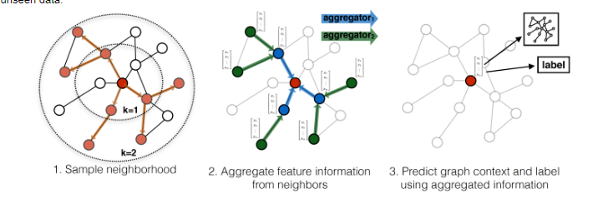
Graph SAGE

Slide 12
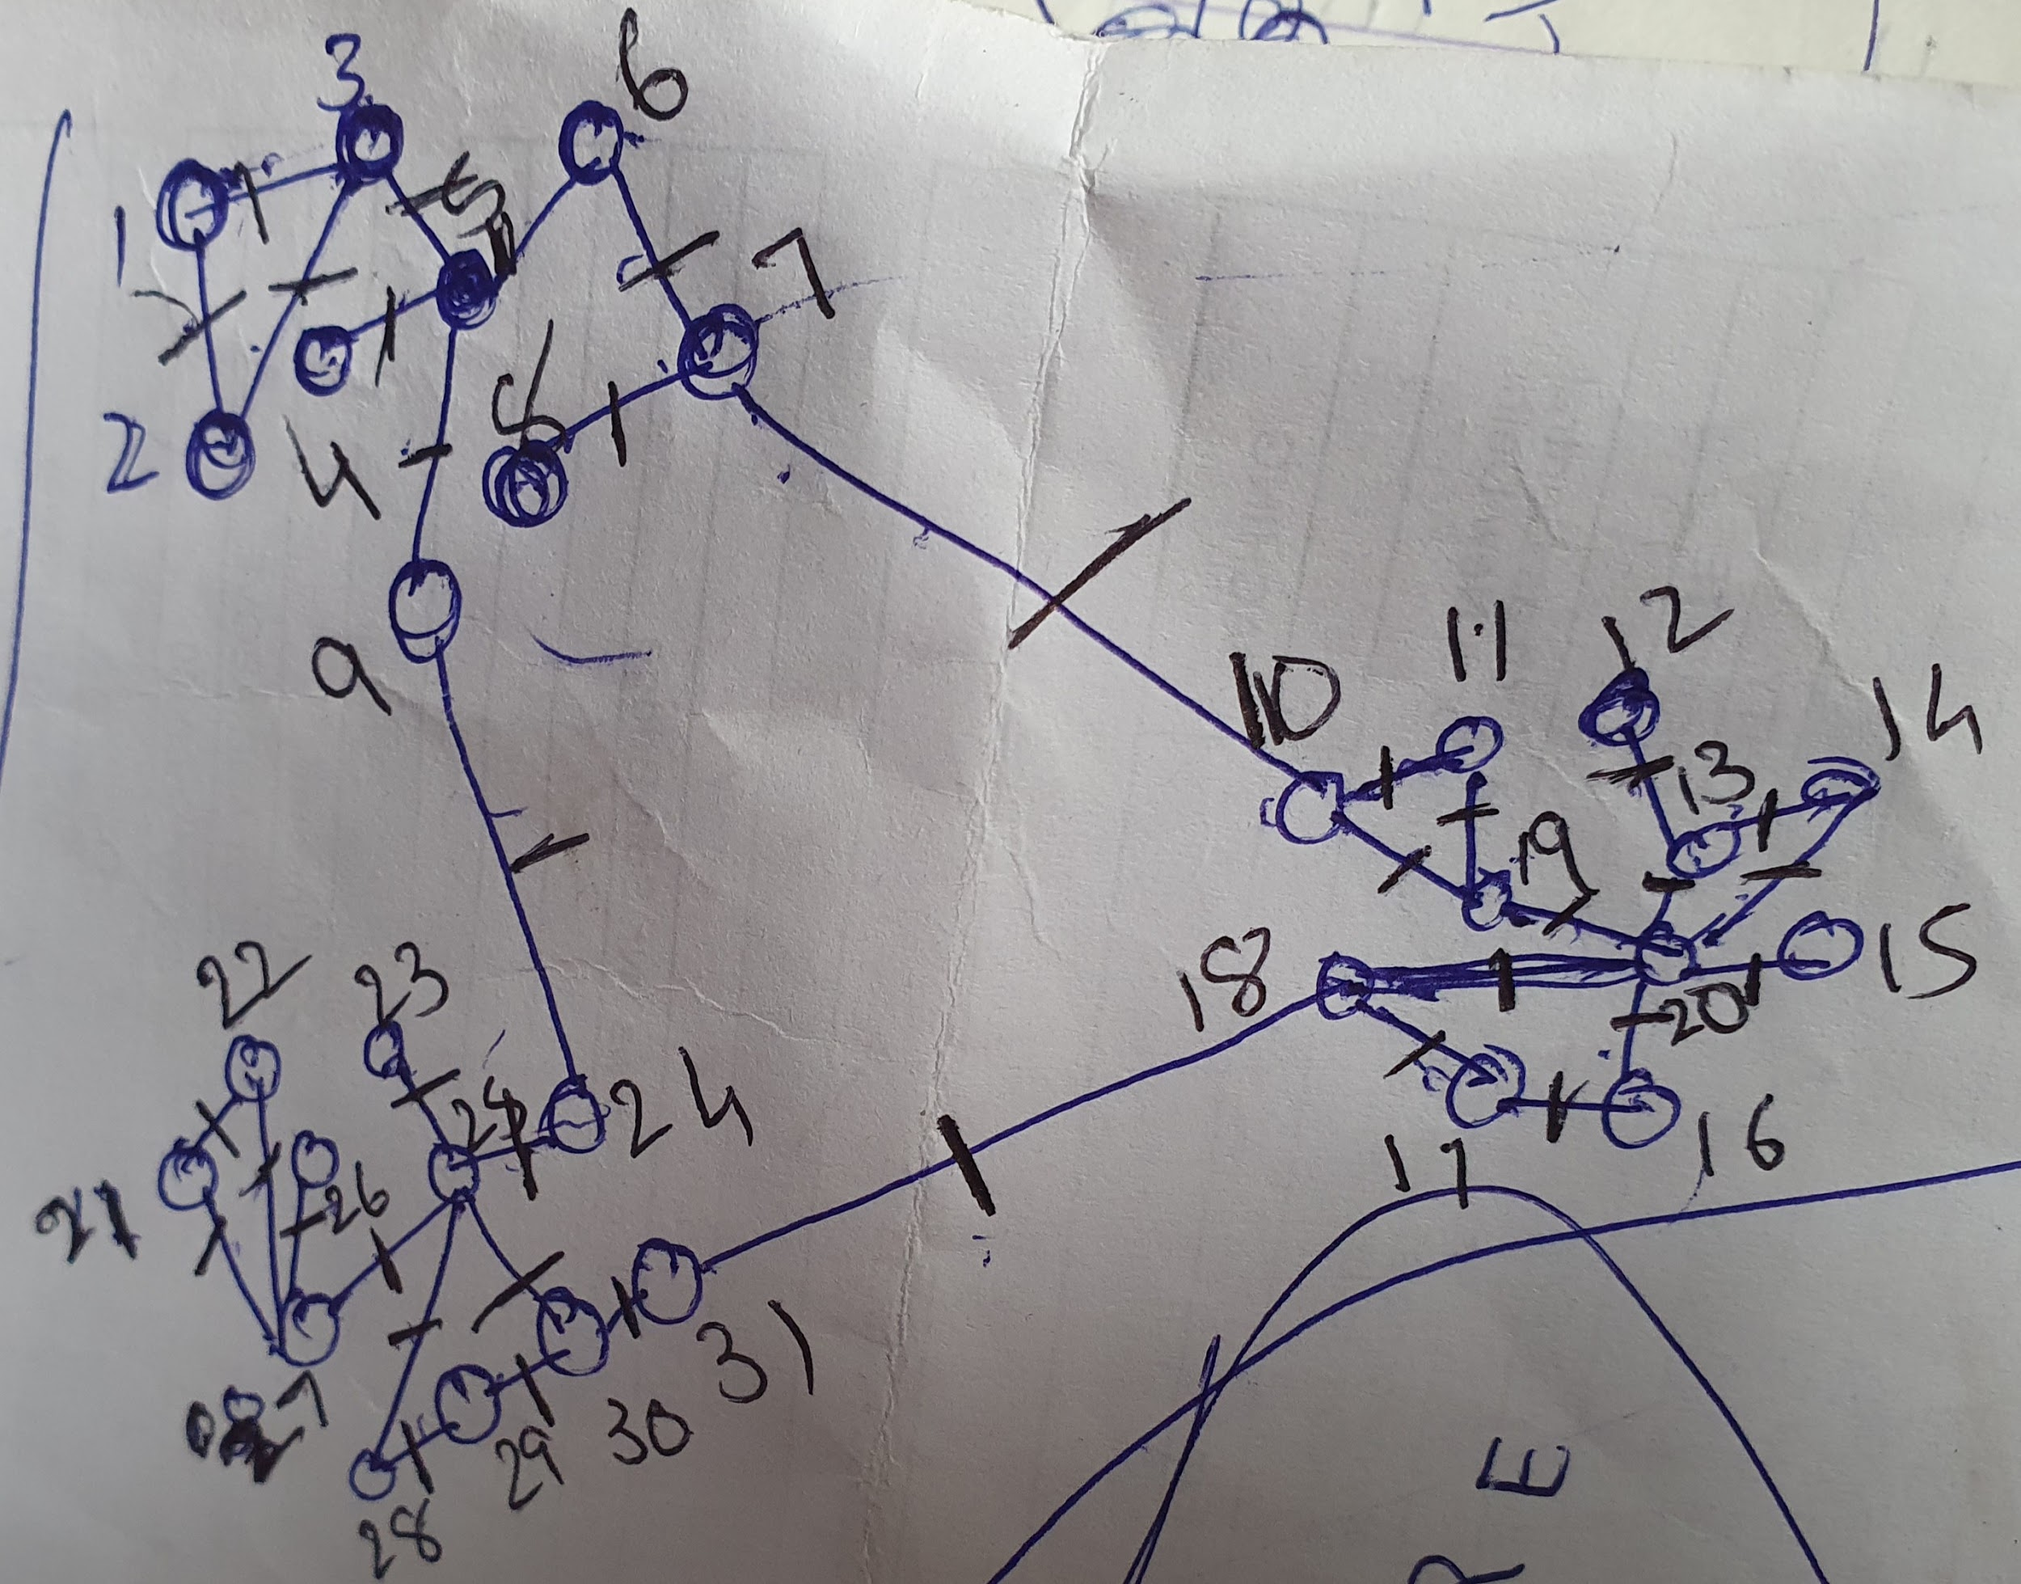
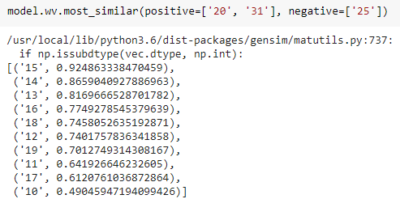
Gateway detection
https://colab.research.google.com/drive/1TtUoMROJv3P0ZGuboYRbrwKGmiiSlNL5#scrollTo=MAipZzUXo7uO

Slide 13
Unexplored
Exploiting the Edge data
Using the nod features in combination with relation data
Reinforcement type or active type of Graph Algorithms
Time series analysis with Graph data

